Slide 1



Python Project
Autodice classes Internship
Year:Dec,2019-jan,2020

Slide 2
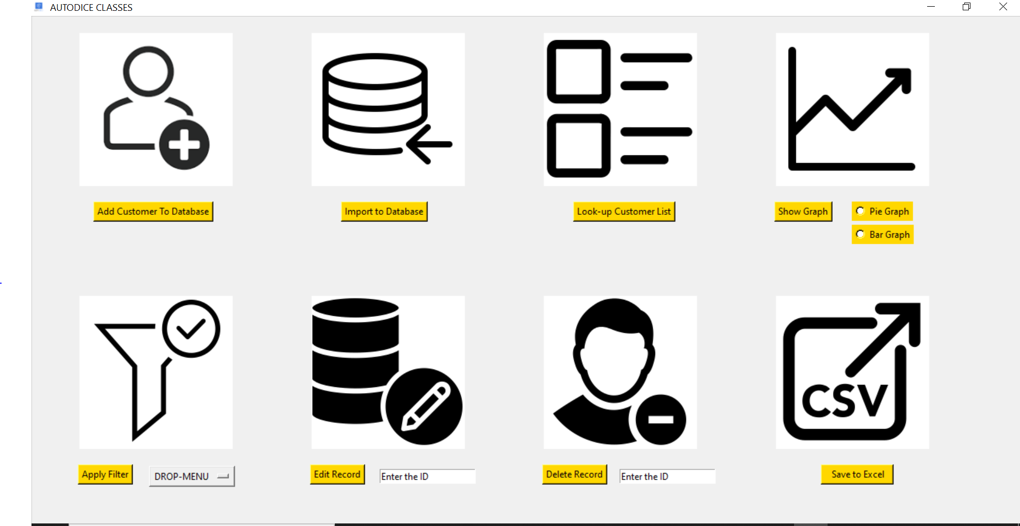
CUSTOMER RELATIONAL MANAGER
CRM is used to manage customer information for various analysis done in business.

Slide 3


OPERATIONS OF CRM
Insert the customer into database
Delete the customer from the database

Slide 4


OPERATIONS OF CRM
edit the records of customer
Creates a csv file of record present in database

Slide 5


OPERATIONS OF CRM
Export the data in excel to the database
opens a new window to see the list of customer present in
database.

Slide 6


OPERARTIONS OF CRM
Filter the customer list according to category.
creates a graph depending on number of categories.

Slide 7
PROBLEM STATEMENT
Customer Management
❏ Login
❏ Forget password - password should be mailed to user
❏ Signup
❏ Import an excel sheet with data
❏ There should be a category(call attended or busy) and sub-category(say for call attended, interested or not
interested)
❏ User should be able to select the category and subcategory about how the customer responded the call by
drop down option and also be able to add a category if not present in drop down
❏ User should be able to select and add the product(multiple products can be selected)
❏ Filter according to various categories or sub-categories
❏ Add, delete or update the info about customer
❏ A pie chart or a bar graph of customer against category or sub-category (i.e. number of customers in a
category)
❏ Export to sheet

